Slide 1

Impact of subliminal perception on motor planning
Capstone Project Phase A
25-2-D-1
Presented by:
Rachel Avidan-King
Daniel Shahar
Supervisors:
Dr. Anat Dahan
Dr. Marcos Hilsenrat

Slide 2
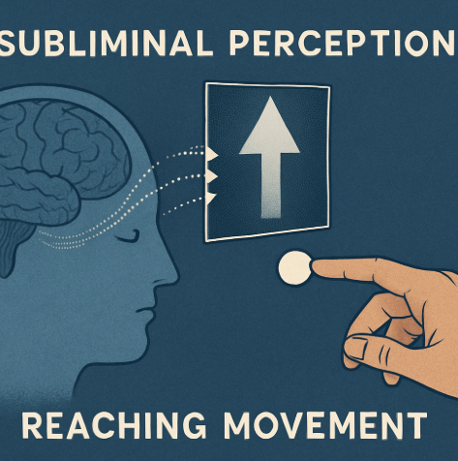
Overview - what’s the final goal?
We intend to create an Android application that will help researchers study the connection between subliminal perception and reaching movement.

Slide 3
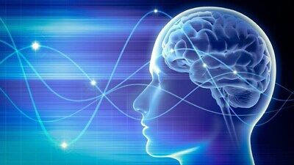
What is subliminal perception?
Subliminal perception is perception without awareness, and the study of how this perception affects our choices. What does that actually mean?

Slide 4

Research
Pierce and Jastrow's (1884) example

Slide 5

Forced Choice Paradigm
An example -
Which picture is brighter, on the left or on the right?

Slide 6
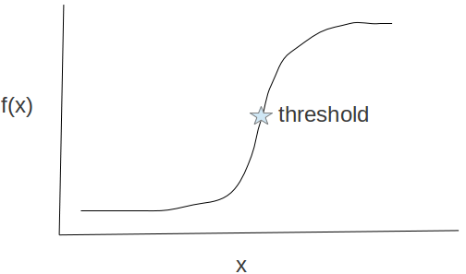
Personal Threshold
Calculations and Chance
Why is it important?

Slide 7
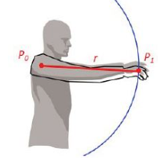
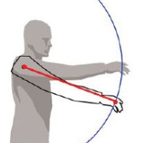
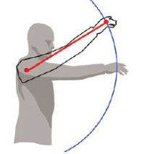
What is reaching movement?
Reaching movement is a motor activity. What does that actually mean?

Slide 8
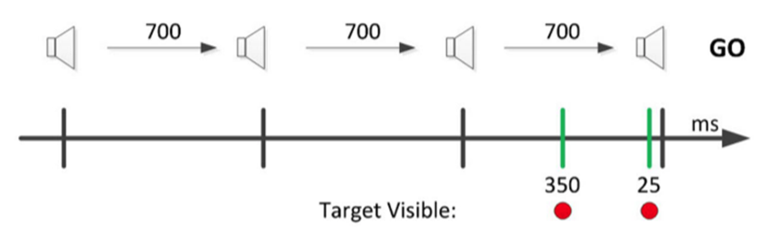
How do we evaluate reaching movement?
Time-Response Paradigm will help us calculate the reaction time, velocity profile, and movement duration

Slide 9
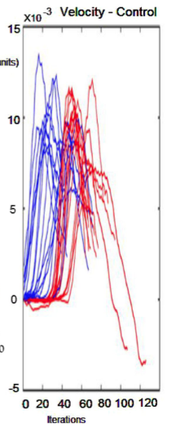
Velocity Profile
An example -
Blue is 350 ms before cue
Red is 25 ms before cue.

Slide 10
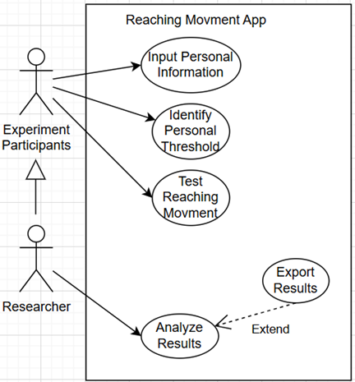
Bringing them together
How does our project combine these two subjects?

Slide 11
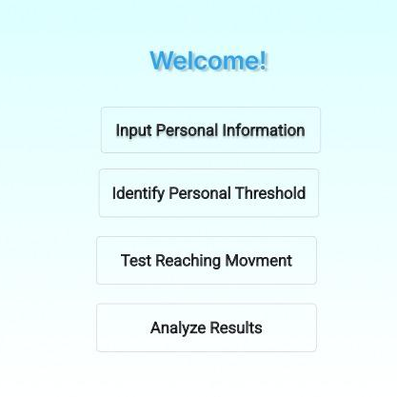
Technical Details
This application will be used on the researcher’s Android Tablet.
It will be built using the Kotlin language.

Slide 12
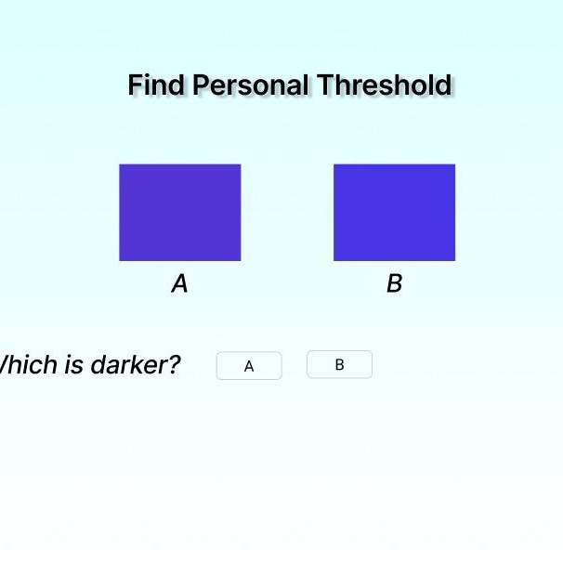
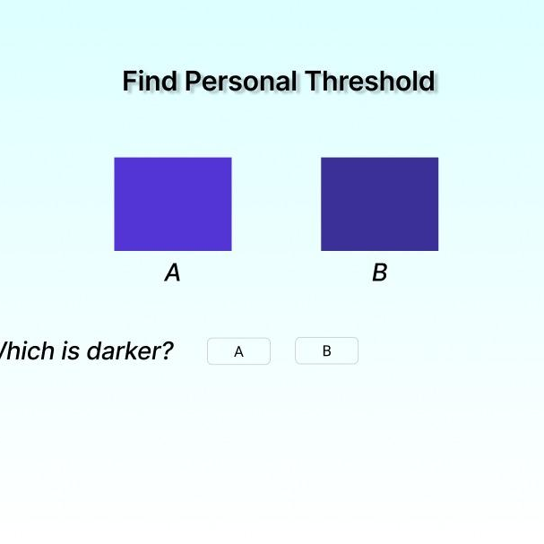
Screens - A
Main Menu
Find the personal threshold Answering a question where they must choose which square is brighter.
X100 For the purpose of calculating their personal threshold.

Slide 13
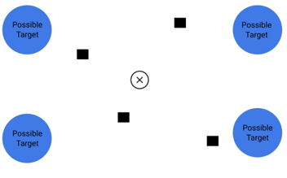
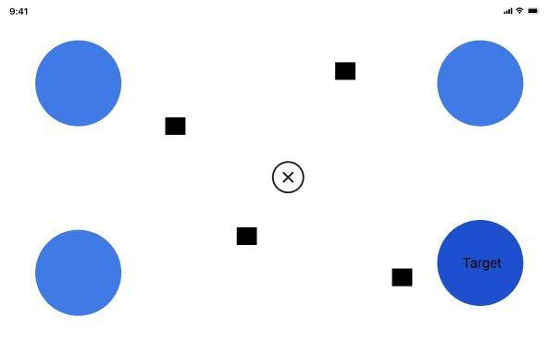
Screens - B
Main Menu
Reaching movement - start
Reaching movement - end

Slide 14
Screens - B (continued)
The participants will see four possible targets and they will have to move their stylus to upon the sound of the fourth beep.
350 milliseconds before the user makes the movement:
The target will be in a clear color, so the user has some time to plan their movement.
The target will be in a color below the user’s threshold, but the user still has time to plan their movement.
25 milliseconds before the user makes the movement:
3. The target will be in a clear color, but the user will NOT have time to plan.

Slide 15
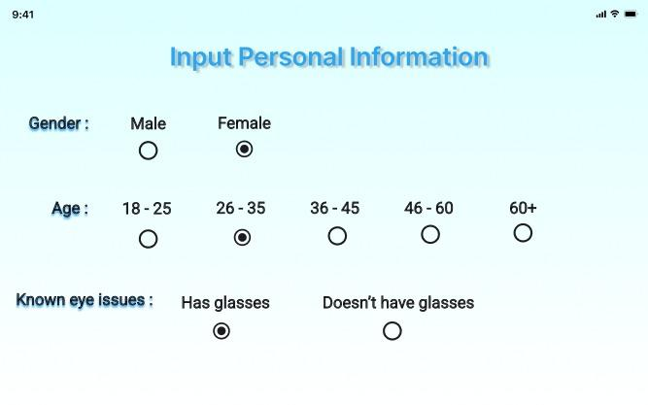
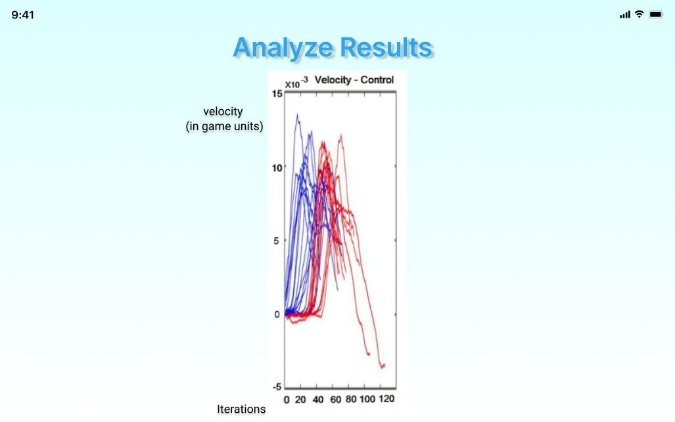
Screens - C
Personal Information
Analyzed Results
A participant of the experiment will input information, to help later data analysis.
Data will be acquired and analized, and will show different graphs based on the researcher’s choice - velocity profile for only women, for example.

Slide 16
Expected achievements
📈 Baseline Measurement Record each participant’s color perception threshold.
🏃‍♂️ Reaching Task Track movement when targets appear at different timings:
Subliminal (350 ms before tone)
Obvious (350 and 0 ms before tone)
📊 Data Collected and Analyzed
Movement start time
Speed profile
Accuracy
🎯 Goal See if subliminal cues affect how early or differently people move.

Slide 17
Evaluation and Validation
🔧 Testing Plan
Accurate stimulus display & color rendering (Android app)
Reliable user input capture & data storage
JND & perceptual threshold calculations (Data Analysis)
Visual clarity & report generation (Results GUI)
👥 User Evaluation
Researchers: Study subliminal cue effects on motor responses
Participants: Experience clear, stable, and responsive tasks
✅ Success Metrics
JND/Threshold Precision: Matches known inputs
Movement Data Validity: Consistent with prior research
Performance: Load time < 3s, frame rate ≥ 30fps
Usability: Seamless navigation & accurate visualization

Slide 18
Thanks for listening!

